Slide 1
Data Catalogue
Sprint 4

Slide 2
Current Catalogue
3 parts:
File description
Column descriptions
Notes
Stored in database table

Slide 3
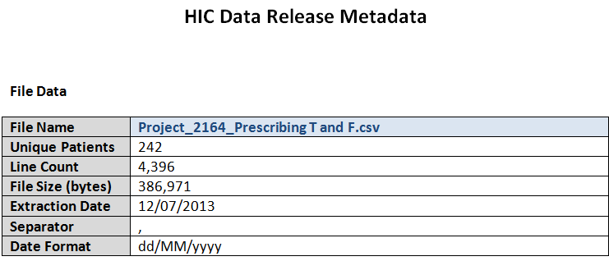

Slide 4
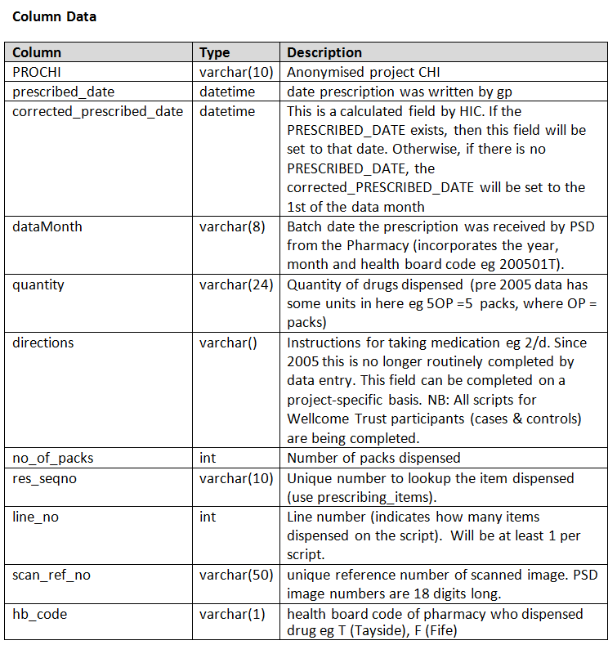

Slide 5
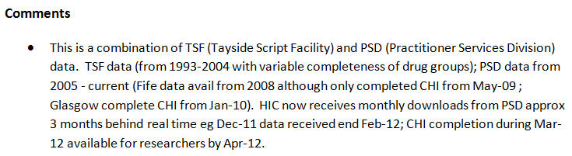

Slide 6
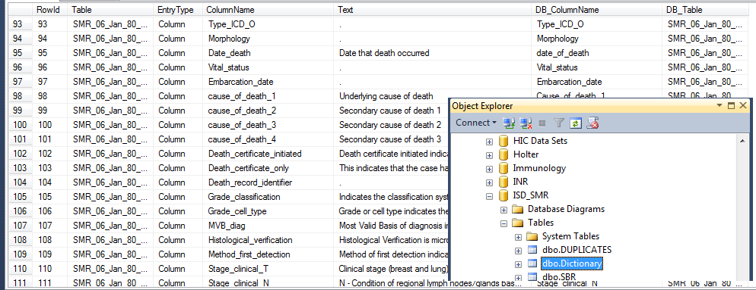
230 Rows in bespoke dataset table
Only 30 are extracted into document

Slide 7
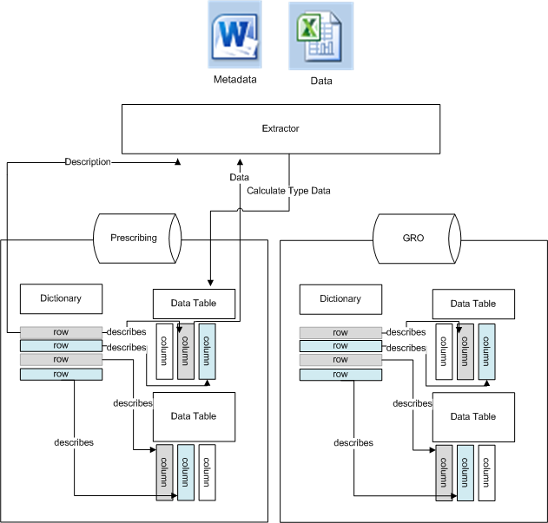

Slide 8
New Method
Entities:
Table level meta data
Column level meta data
Extracted View level meta data (Catalogue)
E.g. Prescribing
Researcher accessible/relevant data
Extracted View Column level meta data (Catalogue Item)
E.g. EGFR column is calculated from X,Y,Z columns

Slide 9
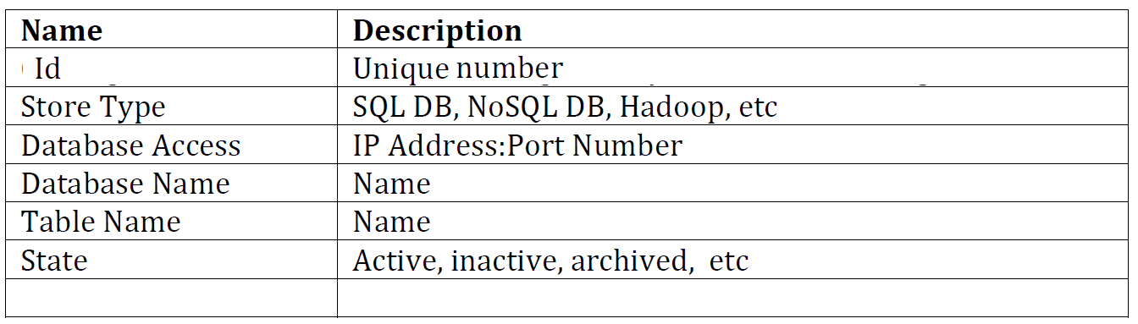
TableInfo Data
ID | 1095
Store Type | SQL
Database Access | EOS
Database Name | CHI_AMALG
Table Name | CHI_ARGYLE_CLYDE
State | DEPRICATED

Slide 10
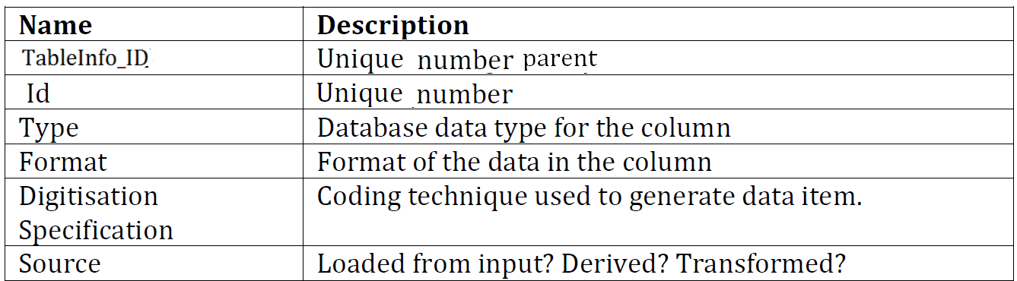
ColumnInfo Data
ID | 107
TableInfo_ID | 1095
Type | char(10)
Format
Digitisation Specification
Source

Slide 11
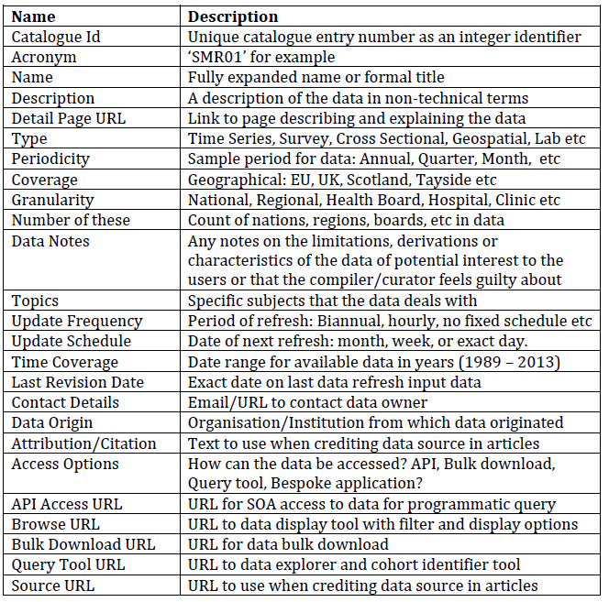
Catalogue

Slide 12
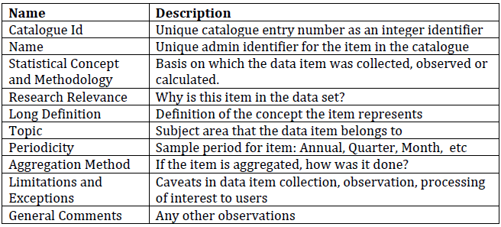
Catalogue Items

Slide 13
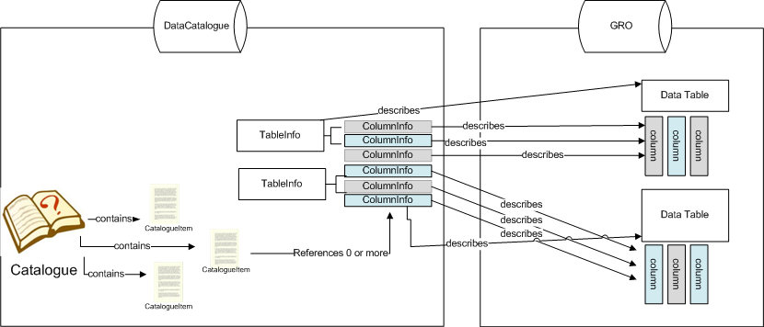
Relationship

Slide 14
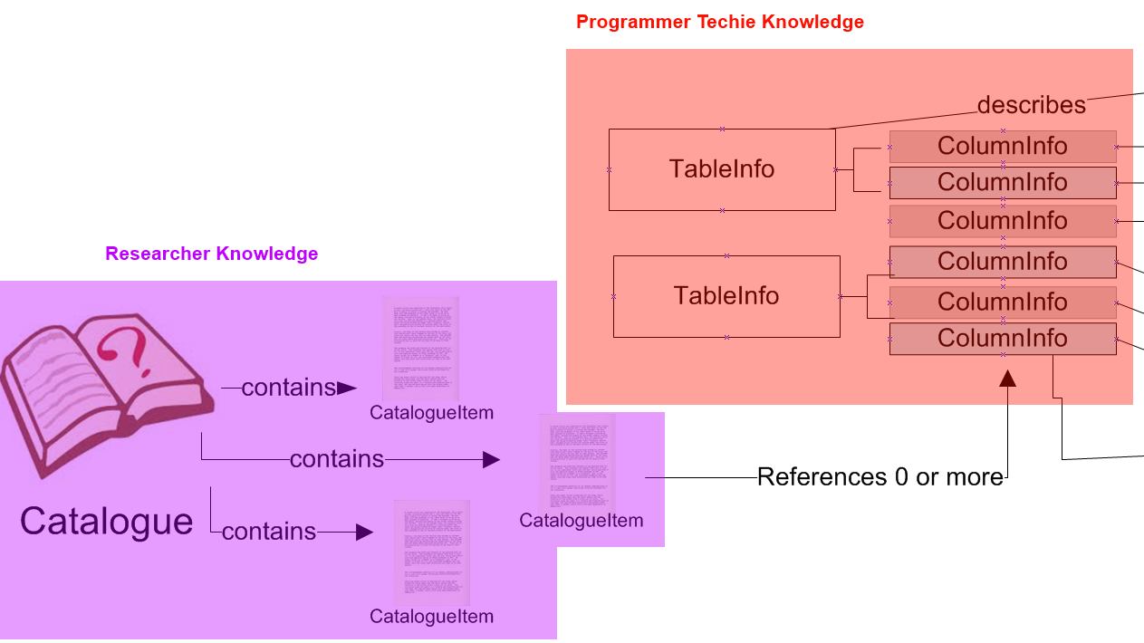
Domain Knowledge

Slide 15
Advantages over old system
Researcher relevant information (Catalogue / CatalogueItem) is kept separately from technical information (TableInfo, ColumnInfo)
0+ relationship between CatalogueItems and ColumnInfo descriptions enable:
Calculated at extract time based on multiple columns
Calculated based on no columns e.g. time of extraction from database
Researcher transforms e.g. 2 CatalogueItems
one for Dave who wants rounding to 2 decimal places
one for Sue who wants rounding to 1 decimal places.

Slide 16
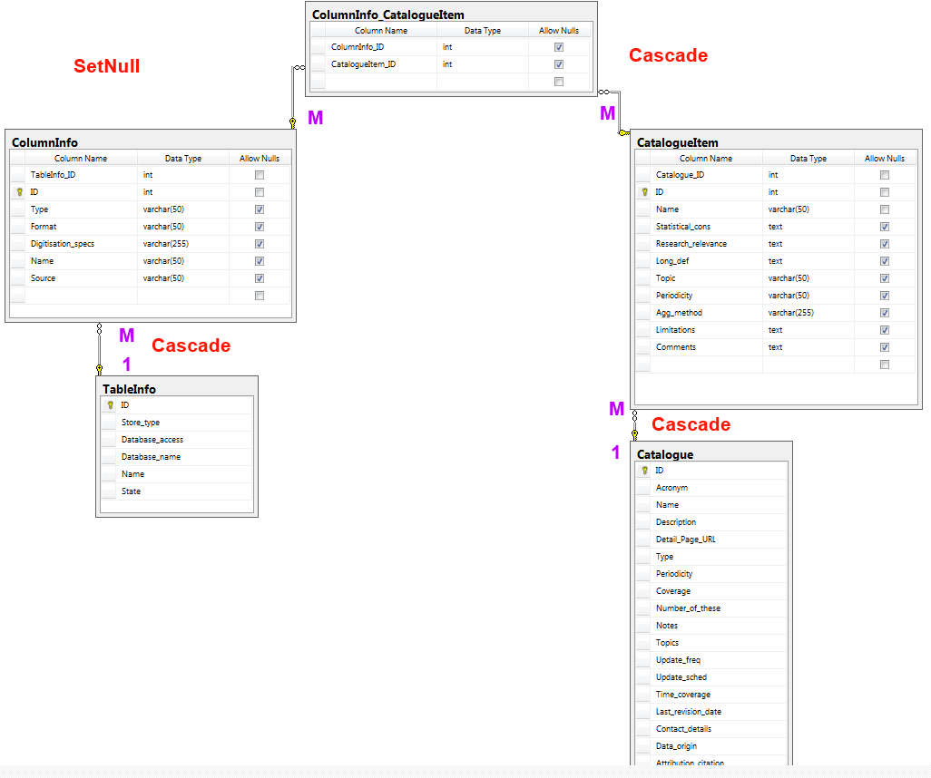
Database Design

Slide 17
Application Prototype

